Slide 1
Scheme granularity:
context and summary
– Rachel Grashion

Slide 2
Overview of granularity of current regimes
What is the current level of granularity within Schedules 4 and 8
For Schedule 4, the ACS is calculated at a route level and then apportioned to and paid at an operator level whereas compensation is paid out at a service group level.
Schedule 8 largely operates at a service group level, with separate benchmarks and payment rates for each service group. However, the Sustained Poor Performance (SPP) mechanism is administered at an operator level, and Network Rail’s targets which the benchmarks are aligned to are set at a regional level.
Discrepancy in measures. Schedule 8 operates at service group level, but key inputs such as NR targets are regional, creating misalignment and complexity.
Ease of calculation: Possession plans are often set out at route level, and so it is easiest to calculate ACS at the route level as today.
01
01
Complexity. Service group level parameters complicate payment forecasts and create multiple compensation rates across operators’ services.
Cost reflectivity. Providing compensation at service group level better reflects costs and losses of differing services.
02
02
BENEFITS
DRAWBACKS
Calibration burden. More granular parameters require additional data, analysis and maintenance.
03
Performance differences: Setting benchmarks at service group level helps to recognise the difference in performance between different types of services.
03
04
Greater volatility. Smaller service groups may produce less stable results and payment rates.
Greater transparency. Setting the schemes at a service group level helps to identify where disruption and improvements occur.
Subjective allocation. Allocation of the calculated route level ACS to individual operators relies on judgement and may be open to challenge.
04
05

Slide 3
Granularity of the performance scheme
Possible levels of granularity
Least granular
Operator
Simple but less targeted
Operator within a Business Unit
Recognises GBR geography
Service Group
More accurate but increases calibration and administrative burden
Service Group within a Business Unit
Adds complexity, but better aligned to GBR geography
Flow
Aligns well with existing research, but may be harder to define individual flows
Service Code
Recognises differences between individual services, but complex
Service Code within a Business Unit
Complex but accurate
Most granular
Which level of granularity feels most appropriate for CP8 and why? How do we strike the right balance between simplicity and accuracy?
Is service group (Schedule 8 and 4 for compensation) and operator (Schedule 4 for ACS) still the right default, or should we align scheme granularity?
Should the schemes recognise GBR geography (i.e. business units) or not? Does this add too much complexity?
Notes:
A flow is a defined group of train services that share a common market, corridor, origin–destination pattern, or section of infrastructure.
For example:
London–Birmingham intercity services
commuter services into Manchester
services using a specific main line corridor
airport express services

Slide 4
Performance scheme additional features
Passenger operators
22 September 2026
Please note, these slides will be published online and will be available, here.

Slide 5
Introduction and purpose
– Caitlin Scarlett

Slide 6
Workshop purpose
This workshop is part of our wider programme of work exploring options for GBR’s future performance schemes.
Today’s session focuses on the additional features that could support the passenger performance schemes (i.e. those which fall outside the core components of the performance scheme, that seek to address specific limitations within the scheme). An example of an existing “additional feature” would be the Sustained Poor Performance (SPP) mechanism.
In the workshop we will:
  Discuss what we mean by additional scheme features, the value they provide, and whether existing arrangements should be retained, simplified, amended or removed.
  Explore whether any additional features could be considered for use in the schemes from Funding Period 1 (FP1) and seek industry views on these.
  Set out our planned next steps and wider programme of work.
Important caveat: All policy options discussed during the workshop carry no legal weight or commitment that they will come into effect. We are seeking industry views to help shape our proposals, ahead of formal consultation.

Slide 7
Overview of the existing additional features and how they add value to performance schemes
– George Willicombe

Slide 8
What do we mean by additional scheme features?
For the purposes of the discussion today, we shall consider that performance schemes are made up of two distinct ‘elements’. Together, these features form part of the overall performance scheme package, and can influence the total level of risk, the incentives in place, and the outcomes experienced.
Core performance scheme
The primary arrangements that are needed for the scheme to function.
Additional scheme features
Supplementary mechanisms that sit alongside the core arrangements and are intended to support how the performance scheme works and address scheme limitations.
This includes the benchmarks, payment rates and a measurement of performance.
The boxes on the right describe current “additional features”
01
02
Sustained Poor Performance (SPP)
Appendix 1 Cap
Provides a mechanism for compensating operators in circumstances where performance issues persist over an extended period to the extent the standard formulaic compensation is no longer adequate.
Limits the amount of lateness of a train or at a monitoring point, preventing exceptionally large incidents from having disproportionate impacts. The cap is reciprocal; applying to both operator and Network Rail.
03
04
Capped Values
Sustained Planned Disruption (SPD)
Limits bonus payments payable to Network Rail where evidence shows an operator’s service(s) are at full capacity and therefore cannot benefit financially, in terms of revenue gain, from further Network Rail performance improvements.
Allows operators to claim actual costs and revenue losses where Network Rail possessions cause sustained planned disruption above defined thresholds. Network Rail may also claim to reduce the compensation payable, where the formulaic payments overstate actual losses.

Slide 9
Where could additional scheme features add value?
Additional scheme features should be considered where they are able to address limitations in the core performance scheme or provide a clear and demonstrable benefit.
Where could additional scheme features add value?
Discussion Prompts
01
Managing financial risk and liability
Balancing and governing financial exposure
Which of these areas are most important to passenger operators?
Do the current scheme features remain valuable, and how well do they work in practice?
Is anything else that concerns you about the existing performance scheme that we could look to address with additional scheme features?
01
Unplanned Disruption
Improving planning and budgeting
Provide greater financial certainty to support budgeting and planning.
02
03
Proportionate outcomes
Ensuring scheme outcomes remain proportionate
03
04
Protection against exceptional events
Limit the effect of severe incidents.
04
Key takeaway: Additional scheme features can address specific objectives but may also increase complexity and should be considered in the context of overall scheme design.
Supporting confidence in scheme outcomes
Promote trust that outcomes of the scheme are fair and credible.
05

Slide 10
Additional scheme features for discussion
– George Willicombe

Slide 11
Scheme features we want to explore
We want to explore with industry colleagues whether additional features could improve the passenger performance schemes.
We have considered four possible additional performance scheme features. Each feature could be iterated further or combined in some way to suit industry preferences.
Neutral zone
Performance zones and scaled payments
Incident and annual caps
Exposure incident caps
Compensation payments would not apply for performance that sits within a neutral zone, recognising that these fluctuations will not materially impact operators.
Payment rates could be varied depending on the scale or severity of performance related incidents.
Different payments could apply once defined thresholds have been reached or exceeded.
Caps can be used to place limits on the financial liabilities that may apply through the performance scheme by stopping payments once a cap has been reached.
Retains a level of exposure; above a defined cap (see option 3) ensuring industry incentives are aligned to mitigate disruption, whilst also providing a sufficient level of protection to GBR and operators.
For each scheme feature, we want to understand whether it could add value to the current scheme, how it could work in practice, and what risks or unintended consequences need to be considered.
Important caveat: The values used in the examples are for illustrative purposes only to demonstrate how the performance feature could work.

Slide 12
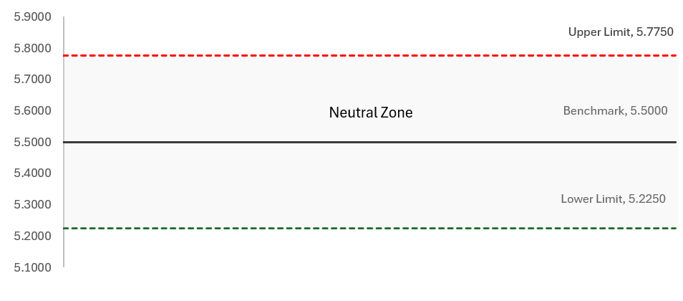
Neutral zones
How could this work in practice?
A neutral zone could be used where actual performance sits within an agreed range (around a target / benchmark) that reflect fluctuations in performance that do not materially impact operator costs or revenues
Why might passenger operators want this option?
Recognises that performance forecasting and benchmarking isn’t perfectly accurate.
Avoids payments being triggered by small movements around the benchmark where the impacts on operator costs, revenues, and services may be limited.
Supports more proportionate outcomes, by focussing compensation on material differences in performance.
Provides greater flexibility in how performance outcomes are treated.
Provides greater predictability for operators by making clear when performance changes are significant enough to affect payment outcomes.
What also needs to be considered?
Performance outcomes can be influenced by where neutral zone boundaries are set and therefore would require careful calibration.
Performance that remains consistently just below benchmark may have a cumulative financial impact that goes unrecognised due to the neutral zone.
A neutral zone may weaken incentives for parties to improve performance within certain ranges.

Slide 13
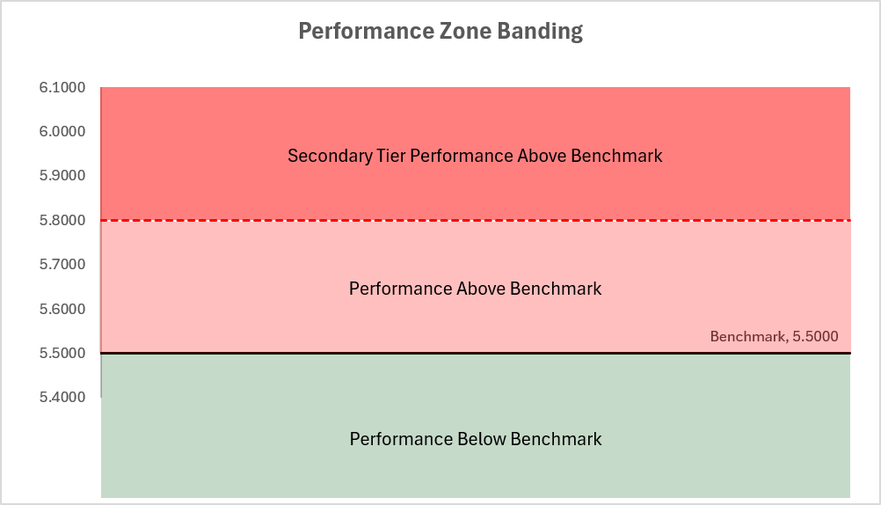
Performance zones and scaled payments
How could this work?
Where performance is better or worse than the calibrated benchmark, payments would be made. The rate of compensation could vary according to the severity of disruption, and according to evidence on the financial impacts.
Where multiple tiers are used, payment rates could be applied on a ratcheted basis, with the higher rate only being applied to the proportion of performance that falls within the specific tier.
Why might passenger operators want this option?
Strengthens incentive for all parties to minimise severe or prolonged disruption, supporting a reduced impact to passenger operators.
Differentiates between minor performance issues and more severe disruption that can have significant operational and commercial consequences to passenger operators.
Can also be combined with neutral zones (see previous slide) to emphasise the incentive on larger deviations in performance.
Performance between 5.5 and 5.8 would attract payments at the standard rate, while performance above 5.8 could attract payments at a higher rate. Outperformance bonuses could be paid at a standard, higher or lower rate, depending on the policy choice.
What also needs to be considered?
It would increase the level of complexity and administrative burden in the scheme; requiring careful design and recalibration.
Additional evidence may be required to investigate the extent to which more severe disruption leads to greater losses.
The approach could increase the level of financial volatility by placing more emphasis on worse performance outcomes.

Slide 14
Incident and annual caps
How could this work?
Reciprocal annual or periodic liability caps could limit the total net performance scheme payments.
Incident liability caps could limit liability from a single disruptive event. These caps could be reciprocal, or operators could pay an Incident Cap Access Charge Supplement (ICACS) in return for the protection of an incident cap.
Why might passenger operators want this option?
Provides certainty over the financial exposure operators / GBR would be subject to.
Protects parties from exceptional or extreme disruption events.
Supports budgeting and financial risk management.
What also needs to be considered?
Incorporating caps into the performance scheme may increase its complexity.
Setting caps and any associated ACS would require careful calibration.
Caps may weaken the incentive placed on parties once liability limits are reached.
GBR and operators face real financial risks beyond the caps e.g. since GBR is still liable to other TOCs for TOC-on-TOC delay beyond the cap, and since TOCs will still experience actual loss for disruption caused to them beyond the capped level.
£800,000 disregarded
Payment of £1,000,000 up to cap limit
£50,000 Excluded

Slide 15
Exposure incident caps
How could this work?
Note: this would only be relevant in a performance scheme which measures TOC-on-TOC performance (unlike the TOC-on-Self regime today).
Operator liability could be calculated in stages, based on the minutes delay (or lateness) caused by a single incident.
Operators would remain fully exposed up until a specific threshold.
Above that threshold, a proportion of minutes delay would be payable, with an option to reduce exposure to delay costs as severity increases.
An access charge supplement could be calibrated to reflect the level of protection provided.
Why might passenger operators want this option?
Continues to provide protection against severe disruption whilst avoiding unlimited financial exposure.
Balances financial protection with incentives to manage disruption.
Minutes Delay | Scaled exposure | Fixed exposure
0-1,000 | 100% | 100%
1,001 – 3,000 | 30% | 15%
3,001 – 5,000 | 15%
> 5,000 | 5%
What also needs to be considered?
The option increases the level of complexity in the performance scheme; requiring additional recalibration activity and administrative burden.
The balance between operator exposure and providing financial protection would require careful consideration
Outcomes may be less predictable than with traditional incident caps.

Slide 16
Workshop summary and final thoughts
The features discussed today are intended to help inform the future development of GBR's performance schemes. We will consider the feedback received on the relative merits of each option, whether any features warrant further development, and are open to exploring alternative options that would provide clear benefits to the performance scheme.
01
02
03
04
Are there any alternative scheme features, not mentioned here or already covered in the current performance scheme, that could be considered?
Is there a mechanism we haven’t considered that could promote better collaboration between GBR and operators?
Which features should be prioritised for further development or testing?
Are there any proposals that you wouldn’t want to feature as part of the performance scheme?

Slide 17
Next steps
– Caitlin Scarlett

Slide 18
Summary and next steps
Key dates / Look ahead – upcoming performance workshops
Outcomes from technical workshops & scheme design proposals in January 2027 – We will present our emerging scheme proposals, as informed by the feedback provided in the series of technical workshops.
Transitionary adjustments to GBR (if needed) in February 2027 – We will discuss a range of potential transitionary arrangements that could support the introduction of future performance schemes. We will seek industry views on their suitability, appropriateness, and how they could be implemented.
We are in the early stages of developing the additional performance scheme features that could be included in the future performance schemes.
Today’s session has been focussed on gathering industry feedback on the scheme features proposed, their structure, and how they could be used in practice. Similarly, we sought views on whether industry had any alternative features they thought should be considered.
We will reflect on the feedback and discussions in this workshop when considering the additional features that could be used in a future performance scheme; developing initial policy proposals ahead of the formal consultation in April 2027.
For more information on our charges and performance workshops, please visit this link: GBR's Charges and Performance Schemes.

Slide 19
How you can help shape GBR’s Charges Scheme and Performance Scheme Statements for FP1
Ways to get involved:
Technical workshops on important charges and performance scheme topics.
Targeted engagement with freight, devolved bodies, open access, other infrastructure managers, and funders.
We are committed to:
Early visibility of emerging approaches.
Open feedback and transparent reporting.
Listening to concerns and perspectives.
For more information on our emerging proposals for charges and performance , please visit this link: https://www.networkrail.co.uk/industry-and-commercial/developing-gbrs-charges-and-performance-schemes/
If you have any questions or would like to discuss this further, you can contact the team via our dedicated inbox: chargesandperformanceschemes@networkrail.co.uk

