Slide 1
Defining disruption outside GBR’s control
16 July 2026
Please note, these slides will be published online and will be available, here.

Slide 2
Introduction and purpose
– Caitlin Scarlett

Slide 3
Workshop purpose
This workshop is part of our wider programme of work exploring options for GBR’s future performance schemes.
Today, our focus is on the topic of defining disruption outside GBR’s control, in line with provisions within the Railways Bill.
In this workshop we will:
  Provide an overview of the legislative context in relation to this topic.
  Summarise how delay incidents are treated in the existing performance schemes .
  Set out some options around how disruption outside GBR’s control could be defined – and our emerging thinking on these options.
A key objective of today’s session will be to seek stakeholder views on our early stage thinking and understanding key concerns. We welcome stakeholder engagement on this important topic and ask that you come prepared to discuss the options and respond to our specific discussion points.
Important Caveat: All policy options discussed during the workshop carry no legal weight or commitment that they will come into effect. We are seeking industry views to help shape our proposals, ahead of formal consultation.

Slide 4
Context
– Rachel Grashion

Slide 5
Background
Legislative context
    The Railways Bill (clause 65 (3b)) states that, under the performance scheme, GBR may not provide for penalties or compensation for disruption outside its control.
    “But the scheme may not provide for penalties or compensation - to be paid by Great British Railways in relation to any disruption that is outside its control.”
Introduction
The Railways Bill does not define disruption outside GBR’s control. This will be for GBR to define as part of its performance scheme development, following industry discussion and consultation.
In developing its policy in this area, GBR will have regard to its statutory duties, balancing the promotion of high standards of performance, the efficient use of public funds, and the need to provide railway users with sufficient certainty to plan and invest for the future.
Our intention is that disruption outside GBR’s control shall only encompass extreme events or circumstances that GBR truly cannot have foreseen. This will help to avoid excessive risk transfer to operators, which we are keen to avoid. This is also aligned with the comment made in the House of Commons as follows:
  “Where GBR cannot realistically be held accountable for ongoing disruption after an event has occurred, it is right that we protect taxpayer interests. For example, in extremis, if there was an act of terror that impacted part of the GBR network, and police response prohibited GBR from re-opening the affected part of the infrastructure.”

Slide 6
How is disruption treated in the existing schemes?
Schedule 8 is aligned to the Delay Attribution process set out in the Delay Attribution Principles and Rules (DAPR).
In the passenger regime, lateness is allocated to Network Rail and operators based on the proportion of delay minutes attributed to each party through delay attribution. This allocated lateness then drives Schedule 8 payments.
The freight & charter regimes are measured using delay and so the scheme, and its payments are based directly on delay attribution.
All delays are attributable to either NR or Train Operators for the purpose of Schedule 8 (with the exception of Z codes in the passenger regime (Unexplained Delays and Cancellations) of which 50% of the associated delays (over 3 minutes) are attributed to NR, and the remaining 50% attributed to NR and TOCs in proportion to the NR/Operator delay share on the day. All Z codes on NR’s network are attributed to NR in the freight and charter regimes)
Externally caused delays
Examples
Benchmarking
External events, i.e. those not caused directly by the rail industry are either attributed to the Operator (V codes), or NR (X codes).
In the existing regime, all V and X coded delays are considered within the Schedule 8 regime payments.
Network Rail: Trespass, fatalities, weather, bridge strikes, security alerts, bird strikes etc.
Operators: disorder, fatalities, passenger illness onboard, police searches, weather, bird strikes etc.
Whilst NR / TOCs are not responsible for such incidents, they may be able to control the extent of the resulting disruption and take action to prevent / reduce future incidence.
All delays are currently reflected in the benchmark calculations. As a result, NR and operators only truly make or receive payments when delay levels differ from those assumed in the benchmarks.

Slide 7
Options
– Rachel Grashion

Slide 8
Options for defining disruption outside GBR’s control
We think there are four main options for defining disruption outside GBR’s control which could then be applied to the performance scheme, as follows:
Option 1: Do Nothing
Option 2: Exclude
Force Majeure events
Performance Scheme includes payments for all causes of disruption.
Not legislatively compliant as this will include payment for causes outside GBR’s control.
Performance Scheme payments are switched off when a Force Majeure event is declared.
Force Majeure events are entirely beyond GBR’s control so would meet the legislative requirement.
Are there other options we could consider?
Option 3: Exclude all
V & X coded delays
Option 4: Exclude a
sub-set of delay codes
Remove all V & X coded delay from performance scheme payments since they are not caused by the rail industry.
Likely that NR / Operators can control the extent of disruption when these events occur (even if the initial event is not caused by the rail industry).
Complete a review of all delay codes in the DAPR and consider which are outside of GBR’s (and operator’s) control.
Likely that NR / Operators can control the extent of disruption when these events occur (even if the initial event is not caused by the rail industry).
Emerging Thinking: Exempt Force Majeure events from performance scheme payments

Slide 9
Option 2: Force Majeure Exclusions
– Rachel Grashion

Slide 10
What is Force Majeure?
A force majeure clause is a contract provision that excuses parties from their obligations when an unforeseeable, unavoidable event occurs that is entirely beyond their control. It acts as a legal safety net.
Common force majeure triggers fall into four main categories (this is not an exhaustive list):
Natural Disasters
("Acts of God")
Government Actions & Regulations
Human-Made & Geopolitical Events
Unforeseen disruptions caused by human conflict or major civil strife such as: Acts of terrorism, declared or undeclared war, civil unrest, or widespread labour strikes.
Health Crises
Extreme, uncontrollable environmental events such as: Lightning, floods, extreme wind / heat / rain and wildfires.
Official, binding actions by local or national authorities such as: Government lockdowns, wartime embargoes, trade sanctions, or unexpected border closures.
Widespread medical emergencies that cause labour or supply chain failures such as: Pandemics and severe regional epidemics.
Example: GBR and operators should not be penalised for closures, delays, cancellations or significant speed restrictions required due to a lightning strike causing significant damage to the infrastructure or to trains.
Example: Government electricity rationing causes cancellations, speed restrictions, and network delays. Because the disruption stems from direct government action, it could be considered force majeure.
Example: There is a terrorism incident on the railway that leads to partial closures and significant delays on the network.
Example: The railway closes or is capacity constrained due to a government mandated lockdown during a health pandemic (e.g. COVID-19).
Crucial Things to note:
The Force Majeure clause is not automatic: You must formally invoke the clause and typically prove you mitigated the damages.
Foreseeability matters: If a risk is expected or specifically excluded in your contract—such as standard incidents of trespass or predictable bad weather—force majeure cannot be used.
The "But-For" Test: You must show that the event directly made performance impossible, not just more expensive or difficult.

Slide 11
How is Force Majeure currently defined in TACs?
There is a clause for Force Majeure (unforeseen events – see below) within existing Track Access Contracts which provides financial relief in respect of some losses during Force Majeure events. However, this does not currently apply to Schedules 4 & 8 which are still payable when Force Majeure events are declared (by way of the Track Access Contract – this is not a legislative restriction).
The existing clauses places strong emphasis on:
  Providing evidence + detail;
  Timely notification and response; and
  Ongoing engagement with the counterparty.
Parties have a right to object to a claim of Force Majeure via the available TAC dispute resolution processes.
IMPORTANT NOTE: For performance schemes we could adopt the existing Force Majeure process or create a bespoke clause with specifically tailored triggers to ensure that the criteria are clear and not open to interpretation.

Slide 12
Pros and Cons of introducing a FM clause for performance schemes
Pros | Cons
Aligns the performance scheme with practical operational realities. | May reduce accountability if the clause is drafted too broadly.
Increases focus and incentive on events that parties can genuinely control / prevent / mitigate. | Could create disputes over what qualifies as force majeure if the triggers / criteria are not clear.
Distinguishes between controllable poor performance and unavoidable disruption. | May weaken incentives to plan, mitigate and recover quickly from disruption, though this can be prevented by ensuring other incentive mechanisms are in place.
Aligns with standard contractual and regulatory practice. | Requires careful governance, evidence and review to avoid inconsistent application.
Recognises that parties can influence response time / recovery management etc. when considering overall relief. | Could shift some financial risk onto operators depending on design.
Narrowly defining exclusions to extreme events increases certainty for operators by ensuring compensation remains payable for the vast majority of performance impacts.
How do we avoid creating incentives to over-claim force majeure where performance payments are at stake?
How do we ensure that focus remains on performance during Force Majeure events?
What governance safeguards would give stakeholders confidence that the process is fair / not open to misuse? Whilst avoiding multiple lengthy claims processes?

Slide 13
Option 3: Exclusion of externally caused delays (V & X codes)
– Rachel Grashion

Slide 14
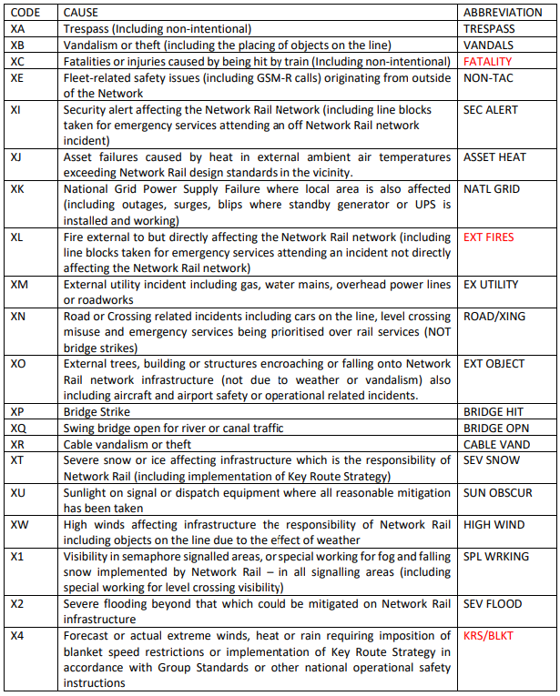
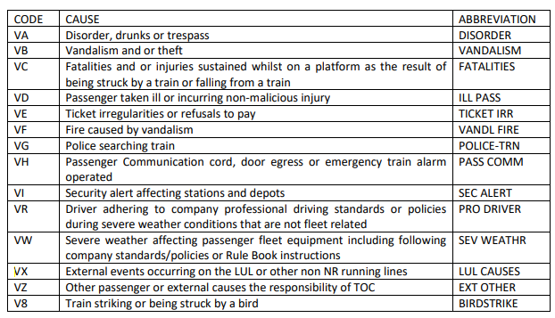
Option 3: Exclusion of V & X codes

Slide 15
Option 3: Exclusion of V & X codes
Pros | Cons
Provides a simple, defined exclusion based on existing V and X delay attribution codes. | V and X codes may not capture all relevant external or exceptional events.
Reduces administrative burden compared with assessing each incident individually (as with FM). | Some delays may have mixed causes, making coding and payment treatment contentious.
Similar approach taken in other European railways. | Could create incentives to code incidents as V or X where payments are at stake.
Reduces disputes by using an existing industry classification system. | Could weaken accountability if too many codes are excluded.
Supports transparency if the excluded codes are published and reviewed regularly. | Requires governance, audit and periodic updates as delay attribution evolves.
 | GBR / operators may be able to reasonably control the extent of delays when they happen.
Question for group: Should V & X codes be considered within GBR’s / TOC’s control, and why? Are there any specific codes which could be considered outside GBR’s / TOC’s control? Could this approach work in practice?

Slide 16
Option 4: Exclusion of a sub-set of delay codes
– Rachel Grashion

Slide 17
Option 4: Exclusion of a sub-set of delay codes
Code | Description
A | Freight terminal operating causes
F | Freight operating causes
I | Infrastructure causes
J | Further infrastructure causes
M | Mechanical of fleet engineer causes
N | Other Mechanical or fleet engineer causes
O | Network Rail operating causes
P | Planned or excluded delays or cancellations
Q | Network Rail non-operating causes
R | Station operating causes
T | Passenger operating causes
V | External events – TOC responsibility
X | External events – Network Rail
Y | Reactionary delays
Z | Unexplained delays and cancellations
Question for group: Are there any categories of delay which might be considered outside of GBR’s or operator’s control? Or any specific codes within these categories? Could this approach work in practice?
Pros | Cons
Reduces disputes by using an existing industry classification system. | Delay codes may not always capture root cause accurately.
Easier to administer than case-by-case force majeure assessments. | Could incentivise coding behaviour since exclusions affect payments.
Maintains incentives for performance where GBR can reasonably influence outcomes. | May be seen as arbitrary if the selected codes are not clearly justified.
Supports transparency if the excluded codes are published and reviewed regularly. | Some events may span multiple causes, making exclusion difficult.
Similar approach taken in other European railways. | Could weaken accountability if too many codes are excluded.
 | Requires governance, audit and periodic updates as delay attribution evolves.
 | GBR / operators may be able to reasonably control the extent of delays when they happen.

Slide 18
Next steps
– Caitlin Scarlett

Slide 19
Summary and next steps
Key dates / Look ahead – upcoming performance workshops
Performance Expectations and Granularity on 9 September – How to set performance expectations / targets within the schemes and at what level of granularity (e.g. operator, service group, service code etc.) the schemes could work at.
Performance Scheme Additional Features on 22 September – Covering any additional elements of the performance scheme which have not already been covered, such as annual caps, incident caps, performance zones / bandings, claims processes etc.
It is our intention that the Performance Scheme Statement (PScS) will set out how disruption outside GBR’s control is defined, and how this is then applied to the performance scheme. The PScS will also consider disruption outside of operator’s control.
We will reflect on the feedback and discussions in this workshop to develop our policy choices on how disruption outside GBR’s control will be defined and considered in performance schemes. We currently expect to formally consult on this topic in Spring 2027.
Stakeholders will have the opportunity to respond to the performance scheme consultation to provide further feedback on these topics.
For more information on our charges and performance workshops, please visit this link: GBR's Charges and Performance Schemes.

Slide 20
How you can help shape GBR’s Charges Scheme and Performance Scheme Statements for FP1
Ways to get involved:
Technical workshops on important charges and performance scheme topics.
Targeted engagement with freight, devolved bodies, open access, other infrastructure managers, and funders.
We are committed to:
Early visibility of emerging approaches.
Open feedback and transparent reporting.
Listening to concerns and perspectives.
For more information on our emerging proposals for charges and performance , please visit this link: https://www.networkrail.co.uk/industry-and-commercial/developing-gbrs-charges-and-performance-schemes/
If you have any questions or would like to discuss this further, you can contact the team via our dedicated inbox: chargesandperformanceschemes@networkrail.co.uk

