Slide 1
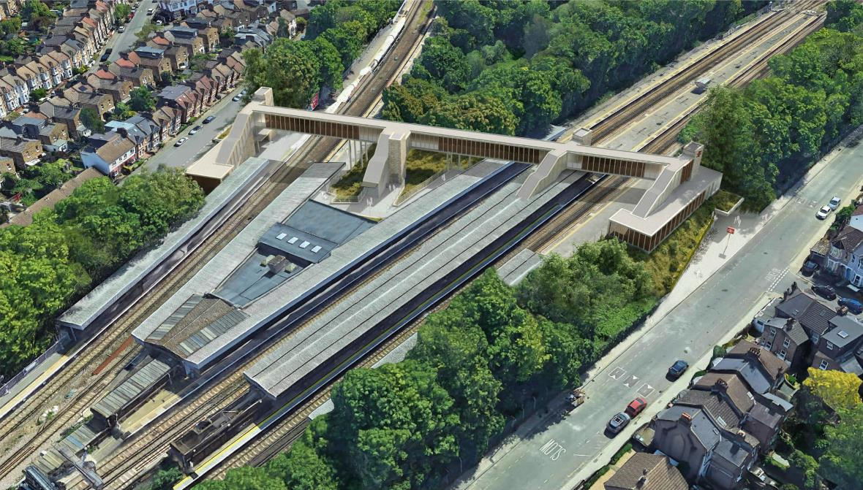
Hither Green AfA
Project Construction Progress

Slide 2
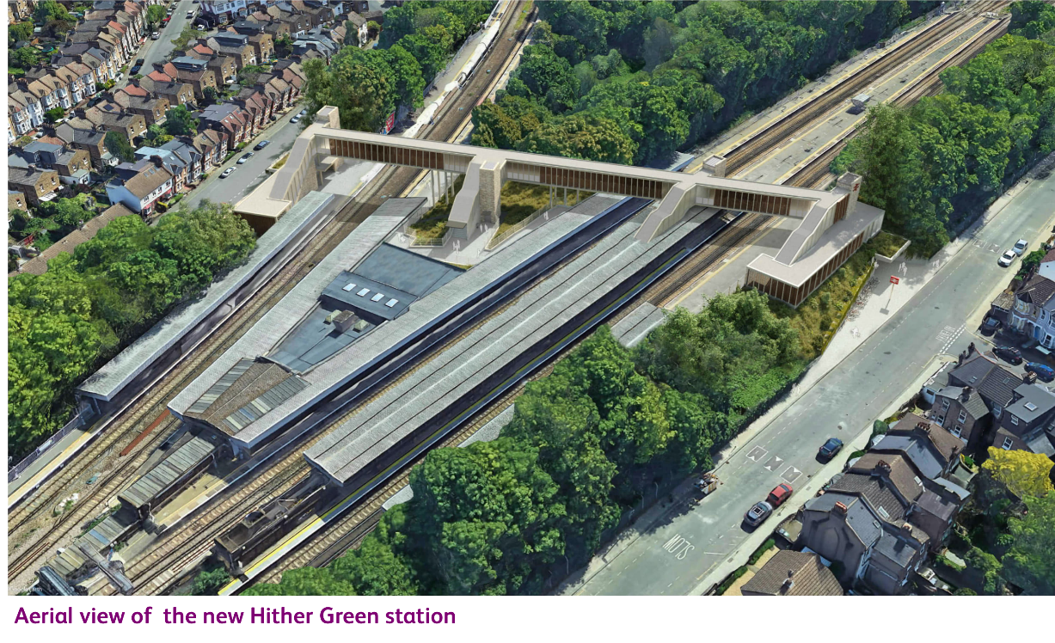
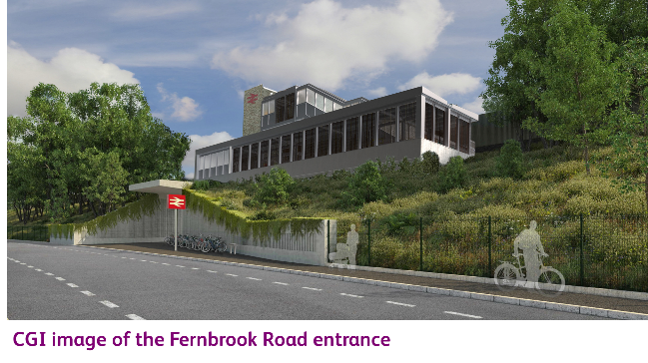
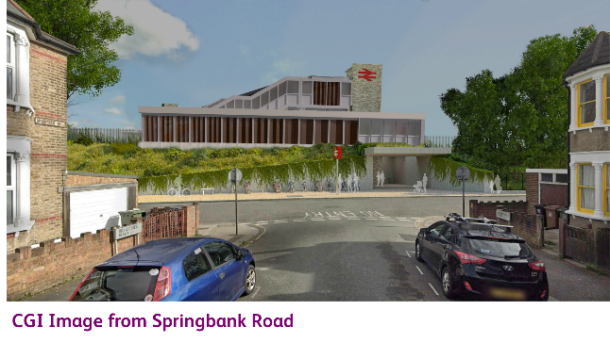
Hither Green Access for All

Slide 3
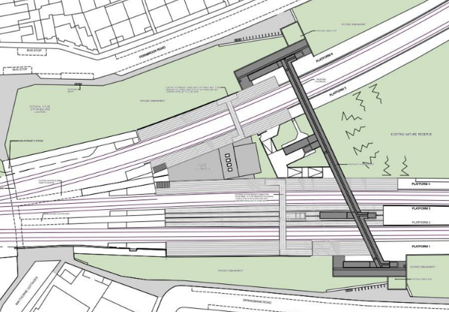
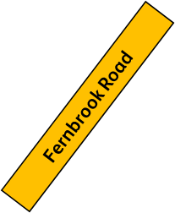
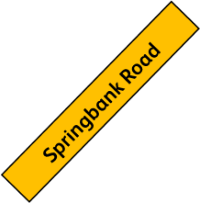
Hither Green AfA - Scope
New Fernbrook Rd Station Entrance
New footbridge spanning over all 6 lines totalling 95m in length
4 new lifts & staircases servicing all platforms
New entrance at Springbank Rd & Fernbrook Rd
New link passageway connecting platforms 4&5
Widening of PL1 and PL6
350m of Gikkon sheet piled retaining wall on embankment.
Civil works (embankment retention, RC works, drainage)
New UKPN 650A Substation
M&E works (lighting, power)
SISS works (CCTV, PA, CIS, TVM, Oyster Readers)
Landscaping and fencing
Nature Reserve reinstatement and replanting
Main Site Compound
(under construction)
PL 6
New AfA Structure
Existing Subway Entrance
PL 5
PL 4
PL 2&3
PL 1
Existing Subway Entrance
New Fernbrook Rd Station Entrance

Slide 4
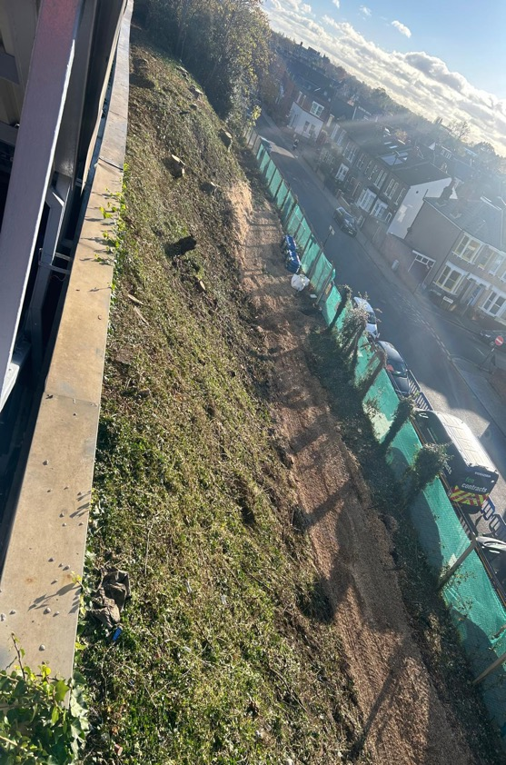
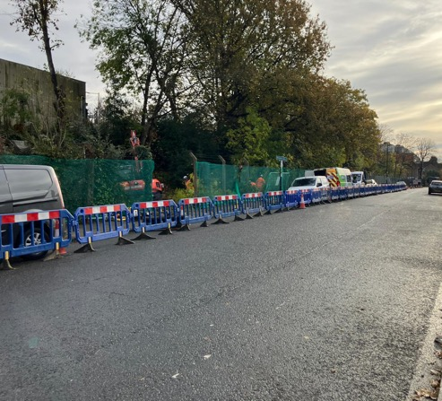
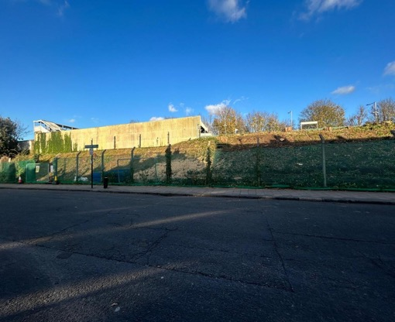
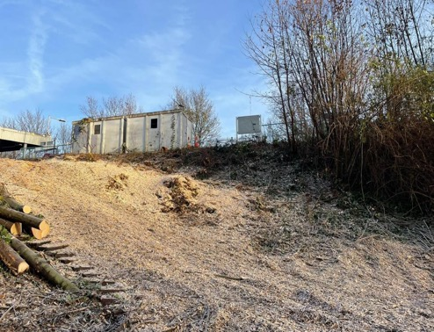
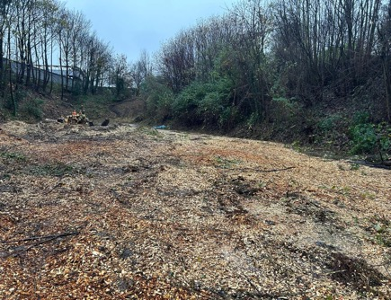
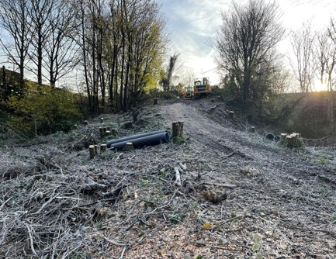
November 2024_Site Progress
Traffic Management Set up on Springbank Road
Traffic Management lifted and footway/ parking bays back open for public use
Vegetation clearance complete at Springbank Road embankment
Vegetation Clearance within the nature reserve
Vegetation Clearance within the nature reserve
Vegetation Clearance within the nature reserve

Slide 5
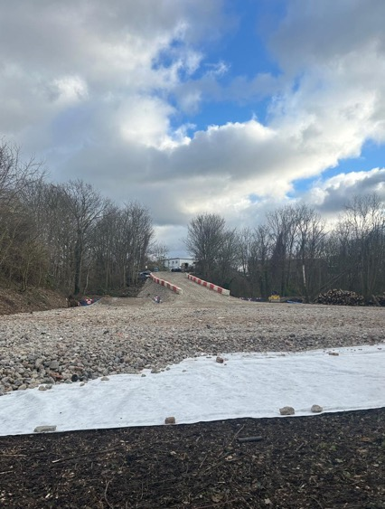
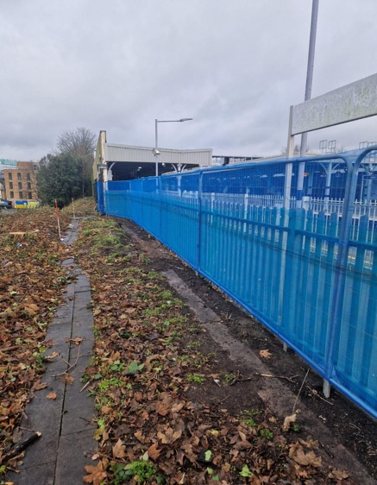
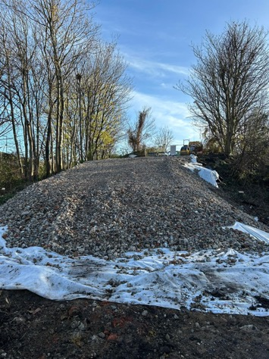
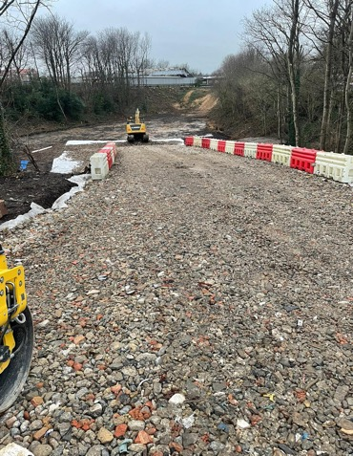
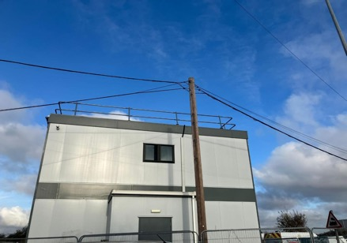
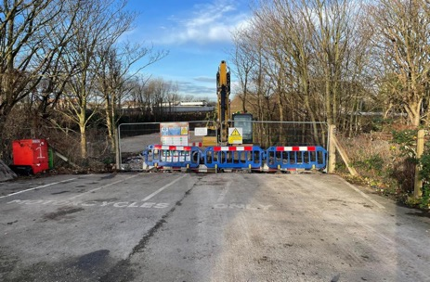
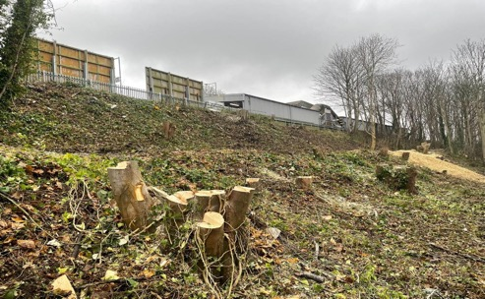
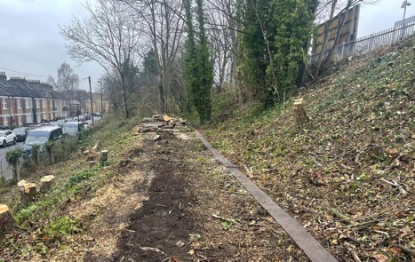
December 2024_Site Progress
Constructing the access ramp in the nature reserve
Constructing the access ramp in the nature reserve
Constructing the access ramp in the nature reserve
Hoarding & debris netting erected on Platform 1
Cables raised in the depot
Site secured during the Christmas break
Fernbrook Road Vegetation Clearance
Fernbrook Road Vegetation Clearance

Slide 6
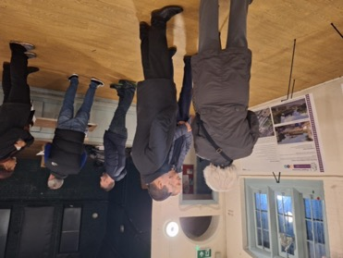
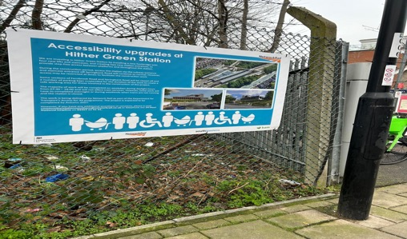
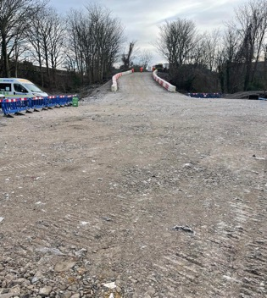
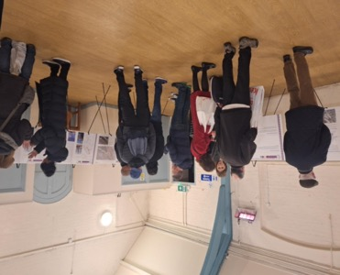
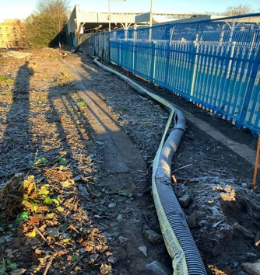
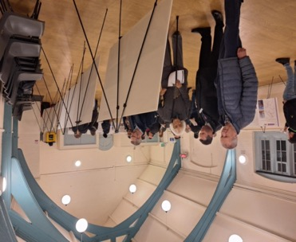
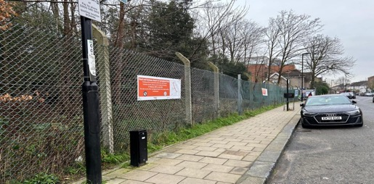
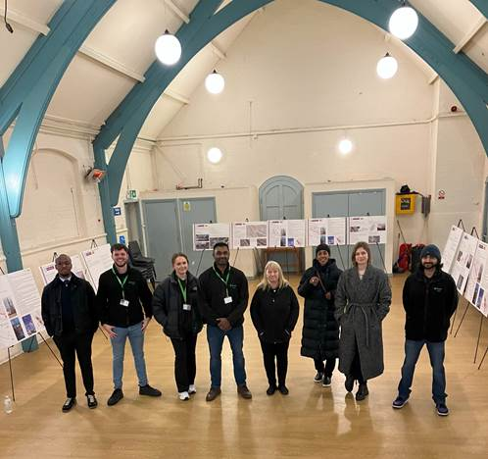
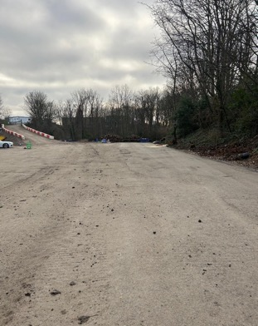
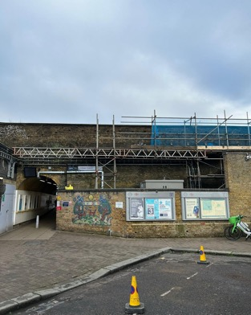
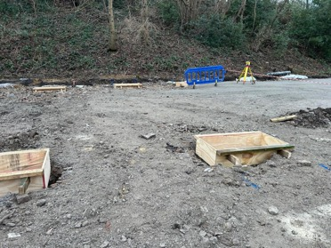
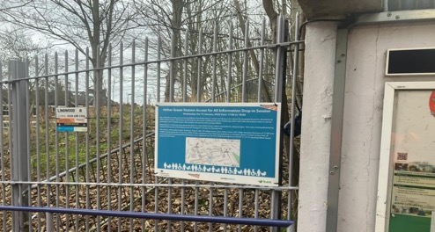
January 2025_Site Progress
Posters installed around the station
Community engagement session
Access ramp and site compound construction
S&T Cable slewed into split ducting
Posters installed around the station
Installing scaffolding to the subway
Installing CBGM in the site compound
Shuttering installed for the concrete footings for the cabins
Posters installed around the station

Slide 7
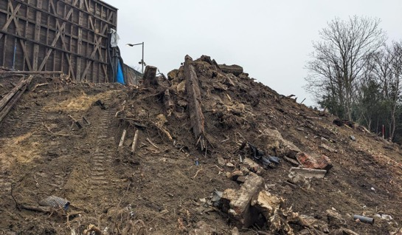
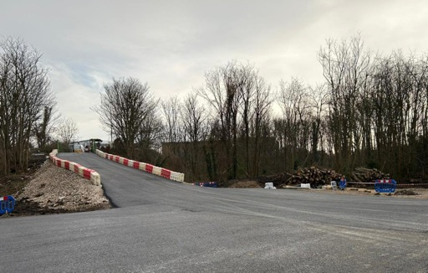
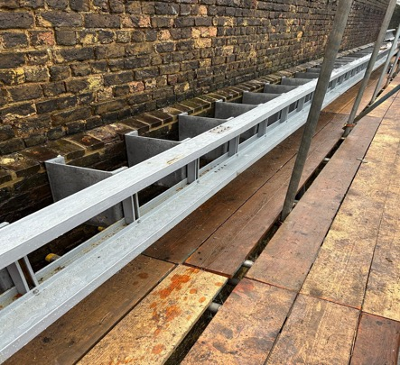
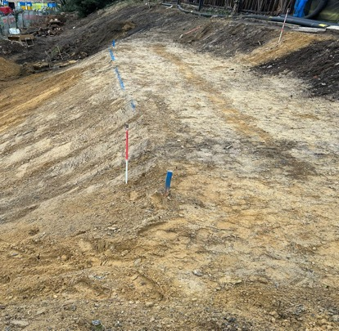
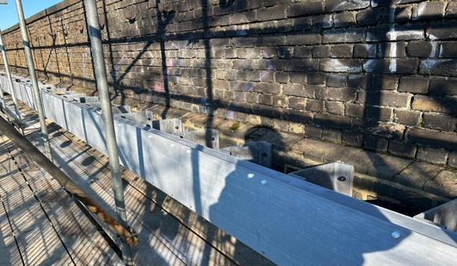
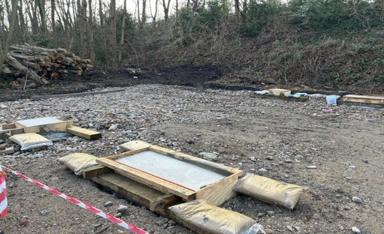
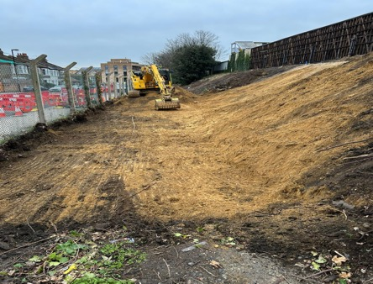
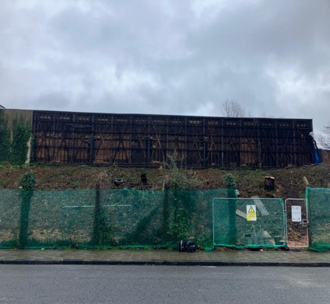
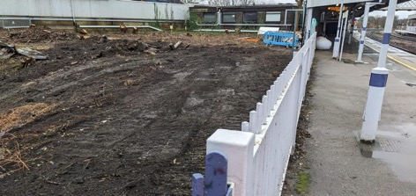
January 2025_Site Progress
Starting the embankment regrade at Springbank Road
Asphalt installed in the site compound
Installing HV containment to the station wall above the subway
Embankment regrade at Springbank Road
Installing high level containment on the station wall above the subway
Concrete footing for the site cabins
Asbestos sheeting removal complete
2No. sheds now removed
Embankment regrade at Springbank Road

Slide 8
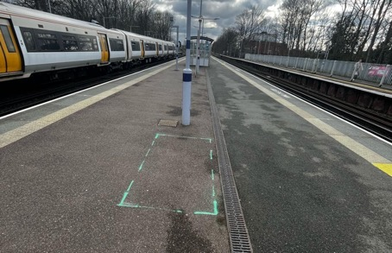
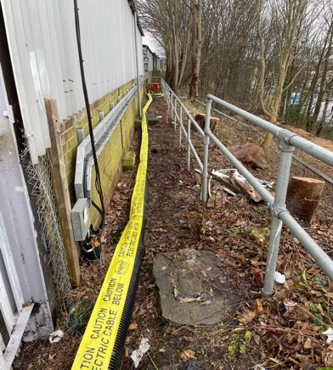
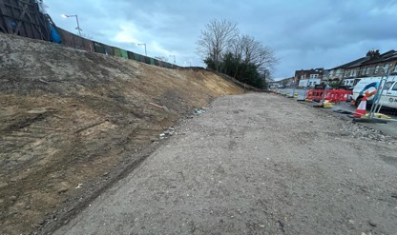
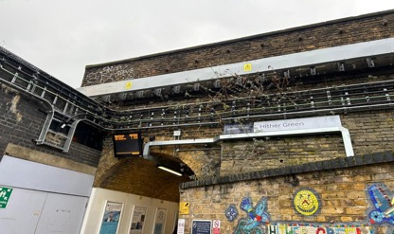
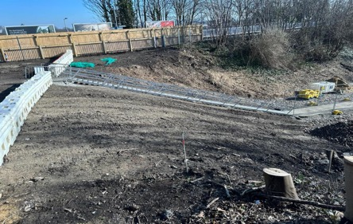
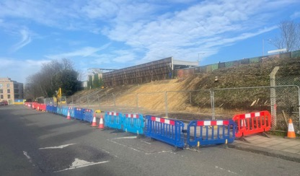
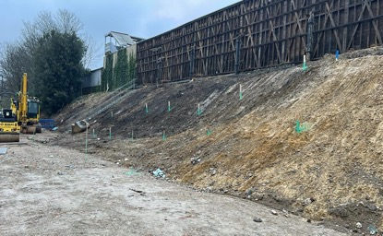
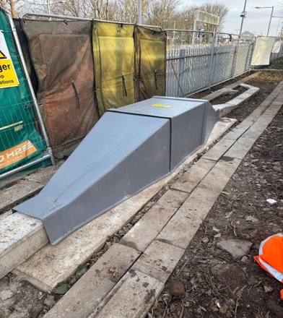




February 2025_Site Progress
CIS base set out ready for Week 49 possession
Embankment regrade and working platform construction at Springbank Road
Scaffold striked over the subway
Fernbrook Road HV diversion works
Embankment regrade and working platform construction at Springbank Road
UXO Survey locations marked out
Staircase to platform 4/5 installed
Plate testing on the working platform
Springbank Road UXO Surveys
Springbank Road enabling – HV feeder diversion
Site Cabins in Compound Area

Slide 9



February 2025_Site Progress
Springbank Road Piling platform construction – Bogmatts installed
Sheet Piles delivered
Crawler Crane mobilised

Slide 10



March 2025_Site Progress
Springbank Rd piling work
Press play

Slide 11




March 2025_Site Progress
Springbank Rd: Installing sheet piles
Vibration monitor installed
Platform 2/3 help point base
Springbank Rd: Installing sheet piles

Slide 12







April 2025_Site Progress
Platform 6- Billboards Removed & Platform Hoarding Installed
Springbank Road- Giken Piling
Fernbrook Road- Embankment Regrade
Springbank Road- Giken Piling
Fernbrook Road- Embankment Regrade
Springbank Road- Giken Piling

Slide 13







April 2025_Site Progress
DOO disconnected and reconnected following cable diversion
Platform 2/3 hoarding
Platform 2/3- Benches relocated

Slide 14






May 2025_Site Progress
Springbank Road- Giken Piling
Fernbrook Road – Piling Platform Construction
Fernbrook Road – Piling Platform Construction
I visited Hither Green Station, to see the £28 million work @NetworkRailSE
are doing to improve the station and make it step free. I appreciate the work they have conducted to include residents in their plans and mitigate their concerns about noise and to disruption. MP, J. Darby
Platform 2/3 Trial holes

Slide 15






May 2025_Site Progress
Springbank Road – HV & S&T cable protection works
Springbank Road- Giken Piling
Platform 1 – TVM Installed
Tree logs donated to Forster Park Primary School delivered to schools
Fernbrook Road- Relocated bus stops
Springbank Road – Scaffolding works

Slide 16






June 2025_Hither Green Site Progress
Platform 2&3 – Lift and stair SFA piling behind platform hoarding
Platform 4&5 – Lift and stair SFA piling
Steel fabrication underway
Springbang Rd – Piling completed and crane de-moblisation underway
Fernbrook Rd – Piling commenced

Slide 17





June 2025_Hither Green Site Progress Rail Minister Visit - Wed 18th Jun

Slide 18






June 2025_Hither Green Site Progress Rail Minister Visit - Wed 18th Jun

Slide 19


July 2025_Hither Green Site Progress
PL1
PL 2&3
Springbank Rd / Platform 1 - Lift and stair foundation works ongoing
Platform 2&3 – Lift and stair foundation works ongoing

Slide 20


July 2025_Hither Green Site Progress
PL 4&5
PL6
Platform 4&5 - Lift and stair foundation works ongoing
Fernbrook Rd – Piling underway through to Sep 2025

Slide 21


July 2025_Hither Green Site Progress – Steel Lift Fabrication underway
All steel procurement has been completed and shop fabrication underway.
Site install shall be in a series of possessions from Wk 27 (28th Sep 25) to Wk 05 (2nd May 26)
Lift 1 fabrication

Slide 22


